Slide 1
5S Organized Work environment
U6 – Improve
E1 – Process Improvement Methods
The element ‘Process Improvement Methods’ sets out a series of methods and tools that can be used for process improvement, such as 5S, Kaizen, 8D, Theory of Constraints and Total Productive Maintenance.
Train the trainer
Notes:
Welcome to this Lean Six Sigma Academy Yellow Belt training module.

Slide 2
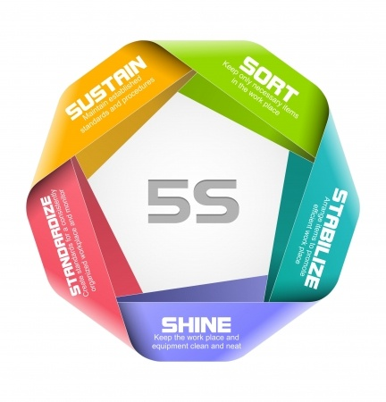
Organized Work Environment
The five steps (5S)
1. Sort
2. Straighten
3. Shine
4. Standardize
5. Sustain
To become ‘World Class’ it is essential to have a committed,
disciplined approach towards good housekeeping
Notes:
The first step in the process to achieve world class manufacturing involves the 5S method. Here we see an overview of the 5 steps that must be taken to arrange a work area in the correct way. First of all, we need ensure that there is dedication and discipline. This is why 5S has to be done jointly with those in the work area. It is also important that there is sufficient communication during the introduction of 5S, this includes communication with other departments.

Slide 3
Organized Work Environment
The 5S technique
Exposes waste and prevents it from re-occurring in the future
Communicates the operation standards of your company to all employees
Improves workplace efficiency
Contributes to a professional look
This technique is part of the set of techniques called:
Organized Work Environment
Notes:
As you can see, 5S is clearly a part of what we call the ‘Organised Work Environment”. By clarifying exactly what is necessary in the work area and clarifying the status of work at the moment, we can create an efficient work space. The company can also obtain a more professional look, making a customer visit possible anytime. An added benefit is that deviations from the normal situation can be easily seen which leads to the prevention of losses.

Slide 4
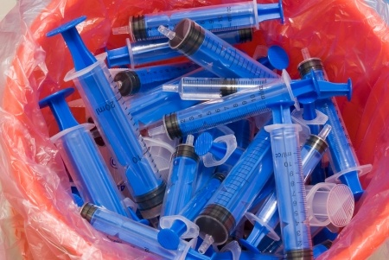
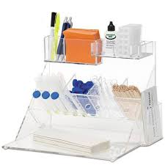
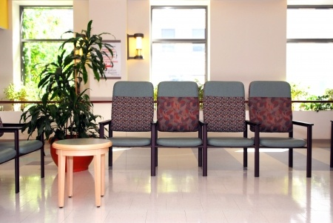
Organized Work Environment
5S
Sort
Nothing unnecessary at your workplace, remove anything not needed
Straighten
Everything has a fixed location
Shine
Keep everything you need continuously clean
Standardise
Make agreements, procedures and standards visible
Sustain
Be disciplined, follow-up on progress, assign owners to audit and stick to procedures
Notes:
We will now give a short explanation of the meaning of the 5 steps: The First thing we want, is to be able to see in the work area, only those things we need in order to perform the daily workload. If we know what these necessary items are, we can take care to create a fixed place for them, so we don’t need to look for them when they are needed. Cleaning the work environment contributes to our ability to visualize any deviations and/or problems early on. With standardization and the visual aspect of 5S, we are able to clearly see when something has to be done, by whom and how often. With discipline and follow-up concerning the progress, we can take care to sustain the 5S system. Audits are also important here and need to take place on a regular basis.

Slide 5
Organized Work Environment
Determine scope
Select the area with most opportunities, afterwards spread
Define target area
Where can we achieve the biggest improvements?
Where is the chance of success high?
Fix start moment
Develop an area map showing all work places, materials, etc.
Perform an initial audit
Photograph problem areas
Notes:
To start a 5S project, we need to chose an area that can serve as an example. It is important to be able to make a clear improvement. We first start with a good assessment of the current situation. We do this by making a floor map and by taking pictures of the ‘AS-IS’ situation. If we have realized the improvements within one department, we can use this to motivate other departments to undertake similar projects.

Slide 6
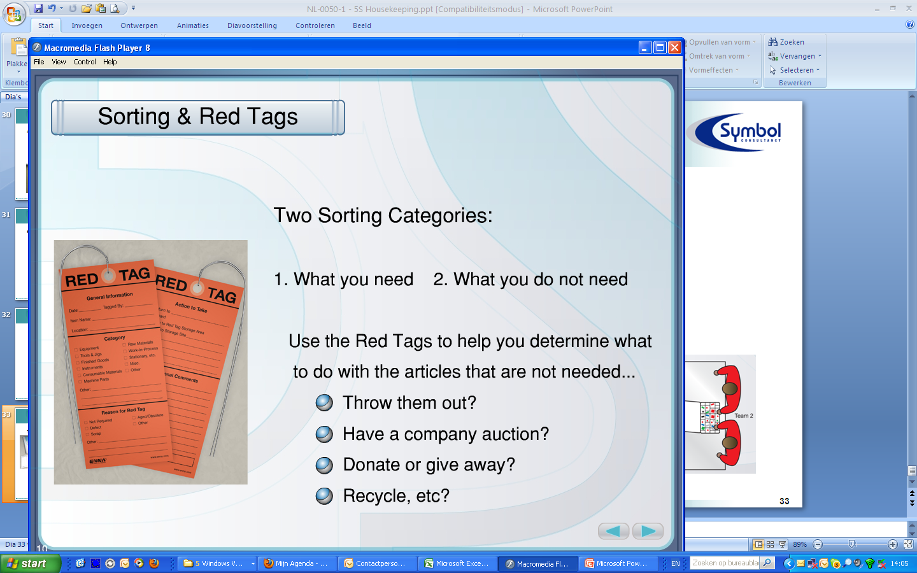
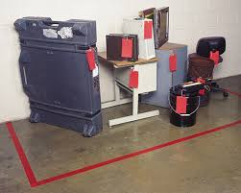
Organized Work Environment
1 – Sort: Rough cleaning
Determine scope and team
Set criterion or conditions before you start
Clean-out anything that obviously does not belong in the area
Reduce the number of items at your work location to only the things you need
Discuss removal of items with all persons involved
‘Red Tag’ procedure
Attach red tags to unneeded items (never needed / not needed for the time being)
Clear out tagged items
Notes:
We will now discuss each step of 5S in more detail. The first step is Seiri or Sort. A team is selected and a department is chosen. Discuss with the team, what is necessary for daily operation and what is extra or unessential. All items not necessary for the daily work of the department need to be labeled with a red tag. Any items that are needed for daily work but that are missing, need to be provided. All of the items with a red tag are placed in a special area to await a decision that will be made concerning what to do with them after informing all concerned personnel.

Slide 7
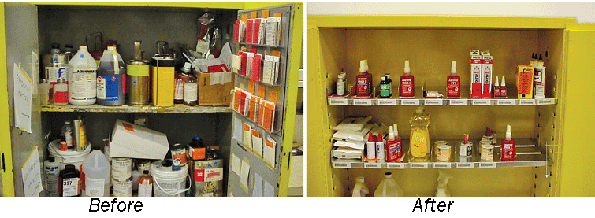
Organized Work Eenvironment
1 – Sort: Rough cleaning
Where do you prefer to work?
Notes:
By removing what is not necessary in daily practice and by making necessary items clearly visible on the shop floor, efficiency is improved. There is less distraction from all of the excessive, unessential materials, and you never miss anything required to perform the tasks.

Slide 8
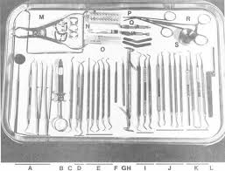
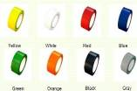
Organized Work Environment
2 – Straighten
Give each item a fixed location
Improve the efficiency of your current workflow
Bring & keep same items together
Combine and group identical / similar items
Writing material, phone, computer
WIP – Work in progress
Racks and boxes (incl. shapes and colours)
Determine how much of each article should be available
Make it obvious where things belong
Lines, labels, signs
Show location, type, quantity, etc.
Notes:
The second step is straighten –each item is given a fixed location, identical items are grouped, and labels and signs demonstrate where items belong.

Slide 9
Organized Work Environment
2 – Straighten
Frequency of Use | Storage/ location | Maximum Distance
continuous | on body / on workplace | max. 50 cm
every hour | on workplace | max. 1 meter
every day | near workplace | max. 5 meter
every week | in department | max. 10 meter
each month | in central warehouse | max. 250 meter
each year | in regional warehouse
less then 1x per year | do you really need it?
Notes:
Here we see a possible estimation of the choices to be made to decide whether certain item needs to be kept. This is dependent on the frequency that the particular item is used in practice. The principle is that what is used frequently must be as close at hand as possible. For all items that are no longer available in the work area , a record must be kept that describes where each item can now be found, for example in the central or regional warehouse.

Slide 10
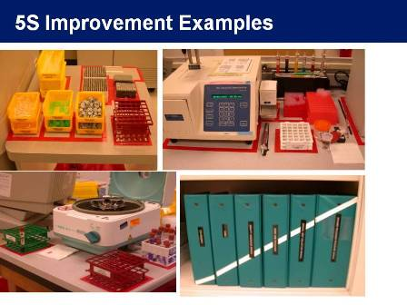
Organized Work Environment
2 – Straighten - Example preconditions
Common used items at fixed location
Binders: in one location labelled
Totes/ storage trays neatly labelled
Label locations with red tape: a place for everything, everything in its place!
Notes:
When straightening, some preconditions exist –all commonly used item are at one location , everything is labelled.

Slide 11
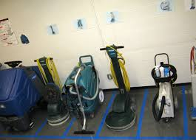
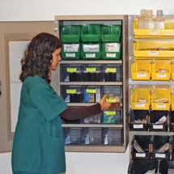
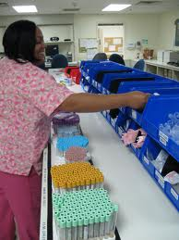
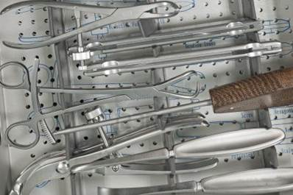
Organized Work Environment
2 – Straighten
Notes:
Here we see some examples of storerooms and workspaces where it is immediately clear what is present or in stock. This prevents any unnecessary searching for tools or materials. To locate tools on the shop floor, the use of shadow boards are preferred because they clearly show which tools are in use or missing.

Slide 12

Organized Work Environment
3 – Shine
Keep your area continuously clean
A clean workplace is an indicator of process quality
Dust and dirt can cause contamination & health hazards
A clean workplace helps to identify abnormal conditions
Clean everything, inside and outside
Don’t forget to also clean inside drawers, top of cabinets, keyboards, etc.
Pay attention abnormalities (broken things, unsafe situations, etc.).
Inspect equipment and repair obvious shortcomings
Make small reparations e.g. leakages, defective light bulbs
Pay attention to missing / broken things, tape and noise
Eliminate all sources of contamination
Prevent dirt, and contamination from reoccurring
Notes:
A consistently clean workspace can only be achieved with regular maintenance and inspection by people on the shop floor themselves. This also prevents problems with spillages and health risks. Deviations like waste, water and spillages are immediately visible. The cleaning and inspection of machines on the shop floor is called ‘first line maintenance’. This type of maintenance also allows you to create higher involvement of the shop floor personnel in the overall improvement process. Finally, it is important to prevent future pollutions by removing the source of pollution.

Slide 13
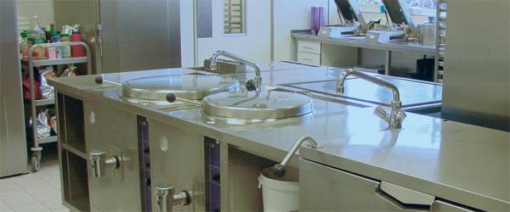
Organized Work Environment
3 – Shine
After the first round of cleaning:
Identify cleaning activities that need to be completed regularly
Define roles and responsibilities
Create and implement a cleaning scheme
Take 5 minutes at the end
of each day/ shift for cleaning
Notes:
If a department is involved in 5S for the first time, they have to decide which cleaning activities and inspections are necessary. A schema must be made that includes the different people responsible for the tasks and the frequency of each task. It is important to allow the people enough time to perform their tasks and it is important that all of the proper tools required to carry out these tasks are made available.

Slide 14
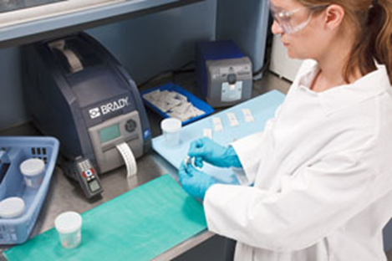
Organized Work Environment
3 - Cleaning - Example preconditions
Keep at least 40 cm free around everything that needs cleaning
Clean desk: empty desks every day
At the end of the day no coffee cups at the workplace
Take 5 minutes time for cleaning and tidying up their own workplace at the end of the day
Clean common areas (cleaning agency) - daily
Clean desks agents (cleaning agency) - weekly
123RF Stock Photo
Notes:
Some preconditions for cleaning include –keeping space free of waste, clean regularly throughout the day and agree cleaning schedules.

Slide 15
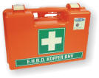
Organized Work Environment
4 – Standardise
Standardise Sort, Straighten and Shine
Establish guidelines for the team’s 5S activities
Make standards and 5S guidelines visible to continuously sustain sorting, storage and shining activities
Detect abnormalities
Develop a system that will enable anyone in the workplace to see problems when they occur
Ensure safety, health, and well-being
Ensure correct clothing, shoes, etc.
Standardise safety items e.g. fire extinguisher, first aid kits
Notes:
Step four is called Seiketsu or Standardize. During this step, the guidelines and standards for the department must be made clear. These instructions have to be available on the work area, preferably in a visual manner. We expect everybody on the shop floor to be able to act if confronted with deviations or problems. Of course there must also be clear visual markers illustrating the standards and presence of health and safety articles.

Slide 16

Organized Work Environment
4 – Standardise
Do not locate tall cabinets in the centre of the office/ room/ ward
Keep the windows clear
Clean wall: no posters on the wall
123RF Stock Photo
Notes:
The last, and possibly most difficult step in 5S is called Shitsuke or Sustain. In this step we must come to realize how we will sustain all of our improvements. We can think about a variety of things here, such as: the training of new employees within 5S systems; The daily time required for cleaning according to instructions or the regular audits by independent persons. Also, the importance of good support from the management must not be underestimated. Managers need to set a good example or ‘walk-the-talk’. It is also important that they are actively involved in rewarding those involved when improvements are made, and acting appropriately when problems arise.

Slide 17
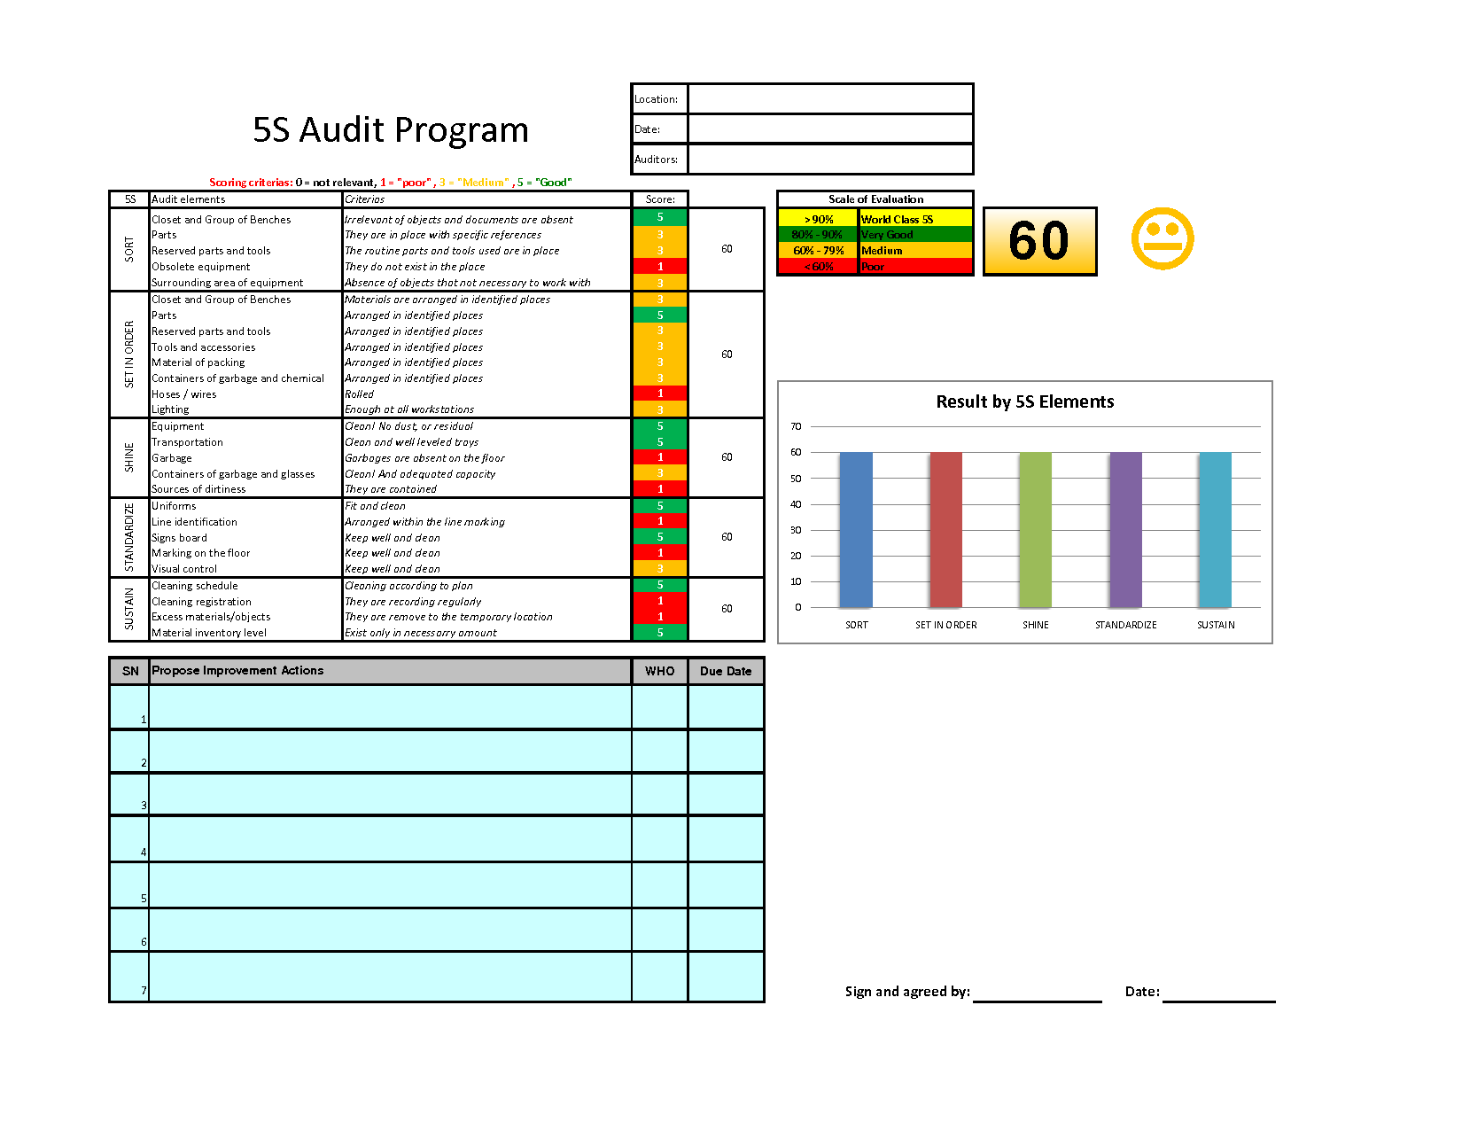
Organized Work Environment
5 – Sustain
Management is responsible for ensuring that guidelines are applied:
Determine how the audit enforcement will be performed
Management must give a good example (‘walk the talk’)
Reward and appreciate improvements, act when it goes wrong
Prepare an audit check list
Perform audits
Notes:
Here we can see an example of a possible control or audit list for 5S. Every department needs to establish a specific list for these inspections, together with the people on the shop floor. By regularly scoring these 5S situations and creating improvements, the awareness in this area increases.

Slide 18
Organized Work Environment
Results of 5S
Less stagnation
Increased safety
Better quality
More usable space
More satisfying work environment
Easier to visualise the process
Find everything you need in 20 seconds
LESS WASTE!
Notes:
Finally, after implementation of 5S, we can see the potential results a 5S project can achieve within a department. We can especially see that the prevention of waste is the first goal, together with improved safety on the shop floor. The direct availability of the right tools, materials and information creates a pleasant work environment. In the end, this will result in a better product quality.
----
We have now come to the end of this Yellow Belt training module. In this session, we have explained the 5S model and each of the 5 steps. The necessity to introduce 5S has been made clear and the advantages have been shown. This method is an important part of the Visual Factory, and a step in the direction towards world class manufacturing.
We thank you for your attention and we hope to see you back soon at the Lean Six Sigma Academy.

